Slide 1

Constitutional Law, Cyber Law and Professional Ethics
Unit-1: Introduction to Constitutional Law

Slide 2
Constitutional Law, Cyber Law and Professional Ethics
Introduction
Constitutional Law is a public law
It is the source of power and exercise of power in itself
All laws in a countries legal regime is structured within the limits of the Constitutional law of the country

Slide 3
Constitutional Law, Cyber Law and Professional Ethics
Constitution
Constitution is legal document(s) which has its roots based on the socio-political history of a nation which also impacts the future of the nation as well.

Slide 4
Constitutional Law, Cyber Law and Professional Ethics
Constitution: Kinds of Constitutions
Constitutions
Written Constitutions
Unwritten Constitutions

Slide 5
Constitutional Law, Cyber Law and Professional Ethics
Constitution: Written Constitution
Written
Formal source of all constitutional powers in the country
Supreme or Fundamental law of the country
Government or organs of the state is creation of the Constitution

Slide 6
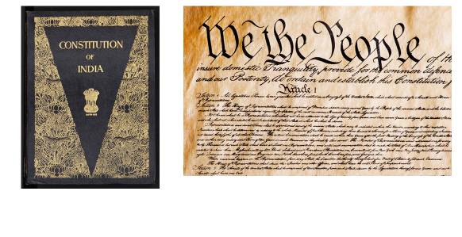
Constitutional Law, Cyber Law and Professional Ethics
Constitution
Example

Slide 7
Constitutional Law, Cyber Law and Professional Ethics
Constitution: Unwritten Constitution
Unwritten Constitution
Combination of regular legislations, conventions
The Parliament or Legislature is sovereign
United Kingdoms has unwritten constitution
Magna Carta, 1215; Provisions of Oxford, 1258; Petition of Right, 1628; Bill of Rights, 1689

Slide 8
Constitutional Law, Cyber Law and Professional Ethics
Historical Perspective of Constitution of India
Constitution of India
came into force on 26th January 1950
adopted on 26th November 1949
Legal history of Constitution of India
Traced back to
Government of India Act 1919
Government of India Act 1935

Slide 9
Constitutional Law, Cyber Law and Professional Ethics
Historical Perspective of Constitution of India
Before Government of India Act, 1919
Acts of 1773 and 1784 were designed to establish a regular system of administration and justice under the Honourable East India Company
The Act of 1833 opened the door for Indians to public office and employment.
The Act of 1858 transferred the administration from the Company to the Crown and laid the foundations of public life which exist in India today.
The Act of 1861 sowed the seed of representative institutions, and the seed was quickened into life by the Act of 1909(Minto-Morley Reforms)

Slide 10
Constitutional Law, Cyber Law and Professional Ethics
Historical Perspective of Constitution of India
Government of India Act, 1919
Passed as a token of gratitude to India’s role in WW-I
Increase native participation in the Government
Creation of Diarchy( Chelmsford-Montagu Reform)
Creation of bicameral legislature in Federal Level
Separate Communal Electorate
High Commissioner in London to represent India in UK
To be reviewed after 10 years
Simon Commission

Slide 11
Constitutional Law, Cyber Law and Professional Ethics
Historical Perspective of Constitution of India
Government of India Act, 1935
Review of GoI Act 1919
Abolition of the diarchy
Establishment of Federation of India( didn’t materialize)
Right to vote with qualifiers
Creation of an almost independent Parliamentary form of Government at Provinces
Establishment of Federal Court

Slide 12
Constitutional Law, Cyber Law and Professional Ethics
Historical Perspective of Constitution of India
Cabinet Mission or Cripps Mission
Set up Constituent Assembly

Slide 13
Constitutional Law, Cyber Law and Professional Ethics
Role of Constituent Assembly

Slide 14
Constitutional Law, Cyber Law and Professional Ethics
Role of Constituent Assembly
An idea for a Constituent Assembly was proposed in 1934 by M. N. Roy
August Offer and Cabinet Mission
1946: Election to Constituent Assembly
389 seats in total
292 provinces
93 Princely States
4 from Chief Commissioner Provinces
United India

Slide 15
Constitutional Law, Cyber Law and Professional Ethics
Role of Constituent Assembly
Two Nation Theory
Indian Independence Act
18th July 1947
Constituent Assembly redrawn
299 Delegates in Total
114 days spread over 2 Years, 11 Months, 18 Days

Slide 16
Constitutional Law, Cyber Law and Professional Ethics
Role of Constituent Assembly
9 December 1946: CA met for the first time
13 December 1946: Objective Resolution
22 July 1947: National flag adopted
29 August 1947: Drafting Committee appointed
Dr. B. R. Ambedkar as the Chairman
6 members of committee
K.M.Munshi
Muhammed Saadulah
Alladi Krishnaswamy Iyer
Gopala Swami Ayyangar
N. Madhava Rao
T. T. Krishnamachari

Slide 17
Constitutional Law, Cyber Law and Professional Ethics
Constitutionalism

Slide 18
Constitutional Law, Cyber Law and Professional Ethics
Constitutionalism
An old concept but gained international traction in the last three to four decades
Constitutionalism is the idea that government can and should be legally limited in its powers, and that its authority or legitimacy depends on its observing these limitations.
Concept of Rule of Law, Social Contract theory by John Locke etc

Slide 19
Constitutional Law, Cyber Law and Professional Ethics
Constitutionalism
Constitutionalism are those concepts and doctrines which puts a limitations on the government to promote governance
Constitutionalism are those limitations which limit the government and maximizes governance
Example
Written Constitution , Independent Judiciary, Judicial Review, Rule of Law, Separation of Power

Slide 20
Constitutional Law, Cyber Law and Professional Ethics
Constitutionalism
A country can have a constitution but may be void of constitutionalism
A country may have no constitution but may have constitutionalism

Slide 21
Constitutional Law, Cyber Law and Professional Ethics
Constitutionalism
Written Constitution
Supremacy of Constitution
Rigid Constitutional Amendment Procedure
Rule of Law
Separation of Power
Fundamental Rights
Fundamental Duties
Single Citizenship
Judiciary
Federalism
Parliamentary Form of Government
Universal Adult Suffrage

Slide 22
Constitutional Law, Cyber Law and Professional Ethics
Salient Features of Indian Constitution

Slide 23
Constitutional Law, Cyber Law and Professional Ethics
Salient Features of Indian Constitution
Written Constitution
Supremacy of Constitution
Rigid Constitutional Amendment Procedure
Rule of Law
Separation of Power
Parliamentary Form of Government
Single Citizenship
Single Judiciary
Secularism
Federalism
Universal Adult Suffrage
Fundamental Rights
Directive Principles of State Policy
Fundamental Duties
Preamble

Slide 24
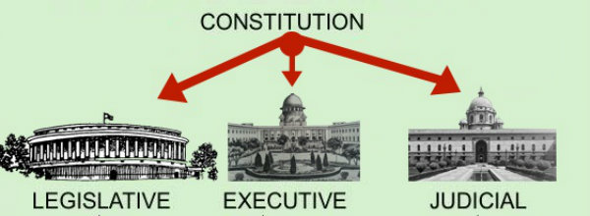
Constitutional Law, Cyber Law and Professional Ethics
Separation of Power
Practical Application of Rule of Law
Aristotle in his book Politics
Locke and Montesquieu [ L’espirit des lois]

Slide 25
Constitutional Law, Cyber Law and Professional Ethics
Separation of Power
Separation of Power
Three Tenants
The same person should not form part of more than one of the three organs
One organ should not interfere with the other organ
One organ should not exercise the functions assigned to any other organs

Slide 26
Constitutional Law, Cyber Law and Professional Ethics
Separation of Power
State
Legislature
Executive
Judiciary
USA, UK, India

Slide 27
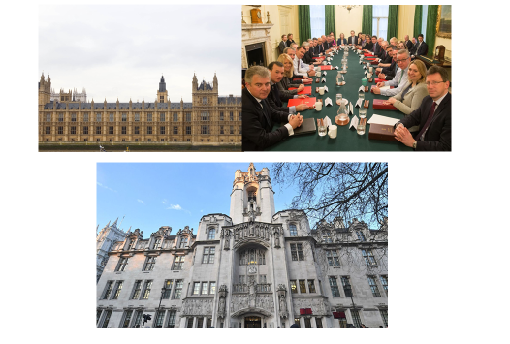
Constitutional Law, Cyber Law and Professional Ethics
Separation of Power: UK

Slide 28
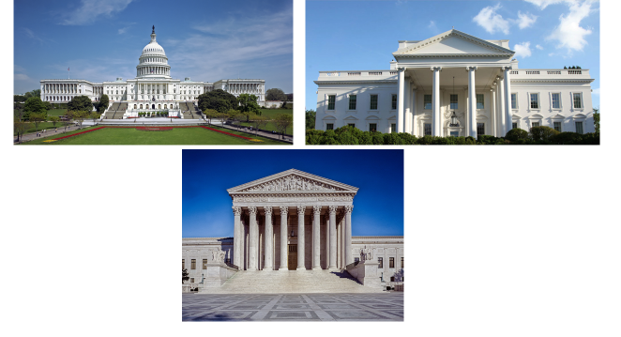
Constitutional Law, Cyber Law and Professional Ethics
Separation of Power: USA

Slide 29
Constitutional Law, Cyber Law and Professional Ethics
Parliamentary Form of Government
Nominal Head of State
Cabinet with Prime Minister
Tenure at the Will of Legislature
Collective Responsibility

Slide 30
Constitutional Law, Cyber Law and Professional Ethics
Parliamentary Form of Government
Why Parliamentary and not Presidential ?
Familiar
Harmony between Legislature and Executive
Responsibility
Assessment
Daily
Periodic

Slide 31
Constitutional Law, Cyber Law and Professional Ethics
Single Citizenship
Constitution of India
Single Citizenship and Single Constitution
One of criticism against federal nature of the Constitution

Slide 32
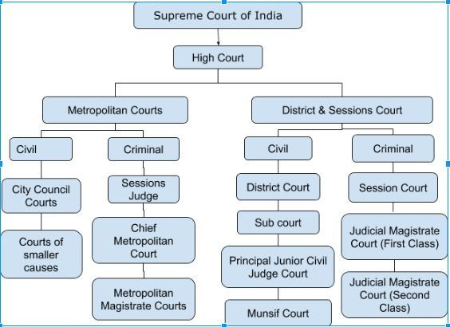
Constitutional Law, Cyber Law and Professional Ethics
Single Judiciary
Constitution of India
Three Tier Unified Judiciary

Slide 33
Constitutional Law, Cyber Law and Professional Ethics
Written Constitution
471 Articles and 12 Schedules (Original 395 and 8 Schedules)
Longest Constitution in the world
US Constitution
Originally 7 Articles
Added 27 articles through amendments
Why written constitution is a salient feature ?
Written constitution: clear and unambiguous

Slide 34
Constitutional Law, Cyber Law and Professional Ethics
Written Constitution
Why such detailed Constitution ?
Division of power between Center and State
Responsibility of various organs of the state
Relationship between Citizens and State
Enforcement of Rights and Duties
Details regarding official language, citizenship and civil servants etc.

Slide 35
Constitutional Law, Cyber Law and Professional Ethics
Supremacy of Constitution
Constitution of India provides framework in which authorities function
Unlike unwritten constitution, written constitution will be the primary source of power
UK : Supremacy of Parliament
India: Supremacy of Constitution
Limits of the powers, privileges etc. is given in clear cut terms in the Constitution of India

Slide 36
Constitutional Law, Cyber Law and Professional Ethics
Rigid Constitutional Amendment
Having a consist and stable constitution ensures a stable legal system
Rigid yet flexible amending process is required in ensuring constitutionalism
Though Constitution of India have been amended 104 times in the last 70 years, the procedure of amendment is difficult

Slide 37
Constitutional Law, Cyber Law and Professional Ethics
Rigid Constitutional Amendment
Article 368
Majority
Special Majority

Slide 38
Constitutional Law, Cyber Law and Professional Ethics
Rule of Law
French principle of “la principe de legalite”
Principle of Legality: Government based on principle of law and not men
Rule of Law
Greek: Right Reason
Aristotle: Moral Justice
St. Thomas Aquinas: Law of God
Indian Philosophy: Dandaniti

Slide 39
Constitutional Law, Cyber Law and Professional Ethics
Rule of Law
Rule of Law made famous by jurist AV Dicey
3 Component
Absence of discretionary power
Equality before law
Independence of legal spirit protected by Court
Propounded while comparing French Legal system and English Legal system

Slide 40
Constitutional Law, Cyber Law and Professional Ethics
Rule of Law
Rule of Law within the Constitution or above the Constitution ?
Rule of Law and Constitution of India
Judicial Review (Art. 13, 32 and 226)
Independence of Judiciary (Article 50)
Equality and Freedom (Art. 14 – 22)
Preamble
Democratic Government

Slide 41
Constitutional Law, Cyber Law and Professional Ethics
Secularism
What is Secularism?
Western Approach: separate religion and state
Interpretation by Indian sources: equal respect for all religion
42nd Constitutional Amendment

Slide 42
Constitutional Law, Cyber Law and Professional Ethics
Secularism
But principle of secularism embodied in the Constitution
Art. 25 to 28 ( Freedom of Conscience, freedom to manage religious affairs and freedom as to payment of taxes for promotion of particular religion)
Art. 15(1), 15(2) (State shall not discriminate any citizen against religion, caste, race, sex and place of birth)
Art. 16(2) (Equal opportunity in matters of public employment and prevents any sort of discrimination on grounds of religion, sex, caste, descent, place of birth and residence.
Art. 29(2) (Protection of Interests of minorities)
Art. 325 ( No person to be ineligible for inclusion in, or to claim to be included in special, electoral roll on grounds of religion, sex, caste and creed)

Slide 43
Constitutional Law, Cyber Law and Professional Ethics
Secularism
SR Bommai v. Union of India (1994) 3 SCC 1
Secularism was held to be basic feature/basic structure of Constitution of India

Slide 44
Constitutional Law, Cyber Law and Professional Ethics
Federalism
Federalism:
mode of political organization that unites separate states or other polities within an overarching political system in a way that allows each to maintain its own integrity

Slide 45
Constitutional Law, Cyber Law and Professional Ethics
Federalism
Features of Federal Constitution
Written Constitution
Supremacy of Constitution
Division of Power
Rigidity of Constitution
Independent Judiciary
SR Bommai v. Union of India (1994) 3 SCC 1
Federalism was held to be basic feature/basic structure of Constitution of India

Slide 46
Constitutional Law, Cyber Law and Professional Ethics
Universal Adult Suffrage
Right to free and fair election
Art. 326
Age 21
Age 18 after 61st Constitutional Amendment, 1988

Slide 47
Constitutional Law, Cyber Law and Professional Ethics
Fundamental Rights, Directive Principles of State Policy & Fundamental Duties
Fundamental Rights: Part III
Art. 12 to 35
Bill of Rights of USA Model
Directive Principles of State Policy: Part IV
Non-enforceable guiding principles for the Government
Irish Constitution
Fundamental Duties: Part IV-A
42nd Constitutional Amendment
Result of Swaran Singh Committee Report
Japanese Constitution

Slide 48
Constitutional Law, Cyber Law and Professional Ethics
Preamble

Slide 49

Constitutional Law, Cyber Law and Professional Ethics
Preamble
Modified version of the Objective Resolution
13TH December 1946
All objectives for CA

Slide 50
Constitutional Law, Cyber Law and Professional Ethics
Preamble
Purpose of Preamble
Who made the Constitution?
What is its source ?
Ultimate Sanction
Nature of Polity
Goals & Objectives
Three Parts of the Preamble

Slide 51
Constitutional Law, Cyber Law and Professional Ethics
Preamble
Union of the trinity
Liberty, Equality and Fraternity
Preamble has no power
Guiding Principles only
Whether Preamble part of Constitution or not?
In Re Beruberi AIR 1960 SC845 (Preamble not part of the constitution)
Kesavanada Bharati Case (It is part of the constitution)

Slide 52
Constitutional Law, Cyber Law and Professional Ethics
Citizenship

Slide 53
Constitutional Law, Cyber Law and Professional Ethics
Citizenship
Constitution of India refers to two kinds of entities in Part III
Persons: Art. 14
Citizens :Art. 19

Slide 54
Constitutional Law, Cyber Law and Professional Ethics
Citizenship
Citizenship governed by
Part II of the Constitution (Art. 5 to 11)
Citizenship Act, 1955 (Act No. 57 of 1955)

Slide 55
Constitutional Law, Cyber Law and Professional Ethics
Citizenship
Part II of the Constitution
Article 5: Citizenship at the commencement of the Constitution (Domicile) (Born/Any of Parents born/Residing in India for 5 years immediately before 26-01-1950)
Article 6: Rights of citizenship of certain persons who have migrated to India from Pakistan (Before 19/7/1948 and after 19/7/1948- Permit System) (Before 19/7/1948 : He/His parents/Grandparents either of them were born in India or he should have resided in India since the migration)

Slide 56
Constitutional Law, Cyber Law and Professional Ethics
Citizenship
Article 6: (After 19/7/1948 : He/His parents/Grandparents either of them were born in India or he should have resided in India since the re-migration for 6 months/ Returned to India under a permit for resettlement/ Submitted application for Registration to the officer/ He has been registered as citizen under such officer)

Slide 57
Constitutional Law, Cyber Law and Professional Ethics
Citizenship
Part II of the Constitution
Article 7: Rights of citizenship of certain migrants to Pakistan. (Overriding effect) (India to Pakistan after 1st March 1947 and re-migrated)
Article 8: Rights of citizenship of certain persons of Indian origin residing outside India. (He/Parents/Grand Parents born in undivided India/ Registered as citizen of India by the diplomat of the country he/she is residing)
Article 9: Persons voluntarily acquiring citizenship of a foreign State not to be citizens.
Article 10:Continuance of the rights of citizenship. (Citizenship continues subject to the laws passed by parliament)
Article 11: Parliament to regulate the right of citizenship by law.

Slide 58
Constitutional Law, Cyber Law and Professional Ethics
Short Overview of Fundamental Rights

Slide 59
Constitutional Law, Cyber Law and Professional Ethics
Short Overview of Fundamental Rights
The protection of socio-political rights
Modeled on US Bill of Rights(Amendments)
Modified for Indian Context
Positive and Negative Rights
Rights specified for classes
Citizens
Persons

Slide 60
Constitutional Law, Cyber Law and Professional Ethics
Short Overview of Fundamental Rights
Part III: 28 provisions
Eight Headings
General: Art. 12 & 13
Right to Equality: Art. 14, 15, 16, 17, 18
Right to Freedom: Art. 19, 20, 21, 21A, 22
Right against Exploitation: Art. 23, 24
Right to Freedom of Religion: Art. 25, 26, 27, 28
Cultural and Education Right: Art. 29, 30
Saving of Certain Laws: Art. 31A, 31B, 31C
Right to Constitution Remedies: Art. 32, 33, 34,35

Slide 61
Constitutional Law, Cyber Law and Professional Ethics
Short Overview of Fundamental Rights
WHAT IS STATE? (Magna Carta- Bill of Rights- Fundamental Rights)
The meaning of State is only applicable to Part-III and Part- IV of the Constitution
Article 12: Definition: In this part, unless the context otherwise requires, the State includes the Government and Parliament of India and the Government and the Legislature of each of the States and all local or other authorities within the territory of India or under the control of the Government of India.

Slide 62
Constitutional Law, Cyber Law and Professional Ethics
Short Overview of Fundamental Rights
Article 12 includes:
Government and Parliament of India
Government and Legislature of State
Local Authority (Municipalities, District Boards, Village Panchayats)
Other Authority.

Slide 63
Constitutional Law, Cyber Law and Professional Ethics
Short Overview of Fundamental Rights
Article 13: 4 principles of Fundamental Rights
Fundamental Rights became operative only after 26-01-1950
Article 13 (1) : All laws in force in the territory of India immediately before the commencement of this Constitution, in so far as they are inconsistent with the provisions of this Part, shall, to the extent of such inconsistency, be void
(Pre-Constitutional Laws: Laws which existed before 26-01-1950, which are not in par with the Fundamental Rights of Constitution of India is considered to be void)

Slide 64
Constitutional Law, Cyber Law and Professional Ethics
Short Overview of Fundamental Rights
Article 13(2): The State shall not make any law which takes away or abridges the rights conferred by this Part and any law made in contravention of this clause shall, to the extent of the contravention, be void
Post Constitutional Laws (After 26-01-1950, the state is prohibited from making any laws which are against the Fundamental Rights.) If incase such laws which are inconsistent to the Fundamental Rights are done it wont apply to the citizens.

Slide 65
Constitutional Law, Cyber Law and Professional Ethics
Short Overview of Fundamental Rights
What do you mean by Law/Laws?
Article 13(3): law includes any Ordinance, order, bye law, rule, regulation, notification, custom or usages having in the territory of India the force of law. (except for administrative directions if only instructions it wont come under the ambit of ‘Law’ under Article 13(3) and second exception to this is personal laws)
Article 13(4) : Nothing in this article shall apply to any amendment of this Constitution made under Article 368.

Slide 66
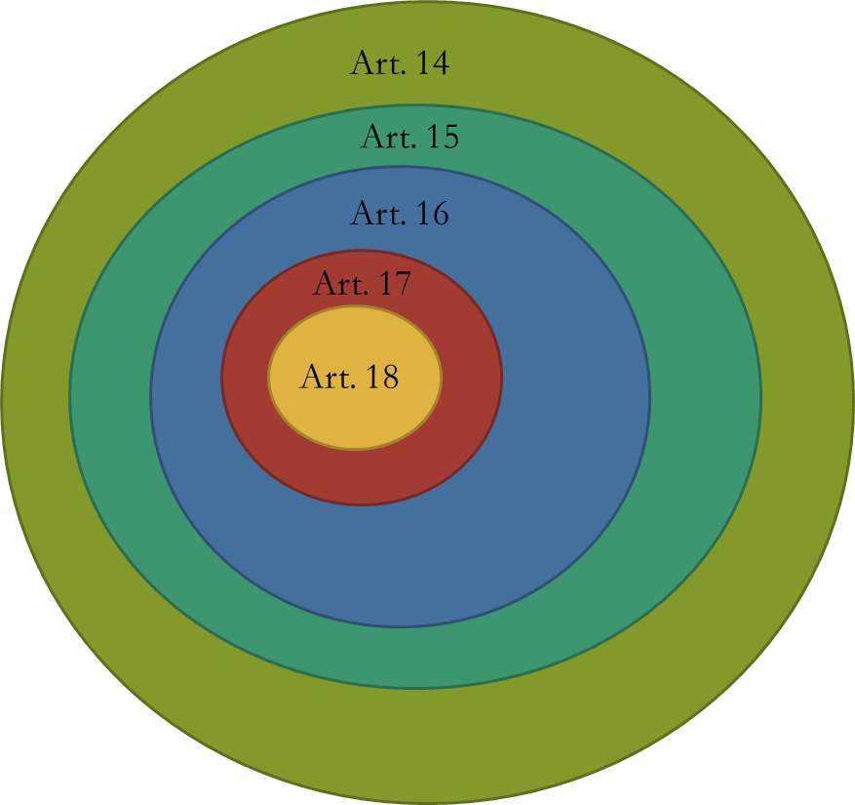
Constitutional Law, Cyber Law and Professional Ethics
Short Overview of Fundamental Rights

Slide 67
Constitutional Law, Cyber Law and Professional Ethics
Short Overview of Fundamental Rights
14. Equality before law : The State shall not deny to any person equality before the law or the equal protection of the laws within the territory of India
AV Dicey in his book “ The constitution of England” had developed the concept of Rule of Law. As per rule of law, no man is superior but the LAW is.
Article 14 emphasizes on prohibition of unequal treatment (Equality before Law) and we have to demand laws which gives equal treatment to all. (Equal Protection of Law) (Positive approach and Negative approach)
No action of state to be arbitrary. Natural Justice and Rule of Law is basic crux.

Slide 68
Constitutional Law, Cyber Law and Professional Ethics
Short Overview of Fundamental Rights
Article 15: Prohibition of discrimination on grounds of religion, race, caste, sex or place of birth
The State shall not discriminate against any citizen on grounds only of religion, race, caste, sex, place of birth or any of them
No citizen shall, on grounds only of religion, race, caste, sex, place of birth or any of them, be subject to any disability, liability, restriction or condition with regard to
(a) access to shops, public restaurants, hotels and palaces of public entertainment; or
(b) the use of wells, tanks, bathing ghats, roads and places of public resort maintained wholly or partly out of State funds or dedicated to the use of the general public
(3) Nothing in this article shall prevent the State from making any special provision for women and children.
(4) Nothing in this article or in clause ( 2 ) of Article 29 shall prevent the State from making any special provision for the advancement of any socially and educationally backward classes of citizens or for the Scheduled Castes and the Scheduled Tribes

Slide 69
Constitutional Law, Cyber Law and Professional Ethics
Short Overview of Fundamental Rights
Article 15: No discrimination on these 5 grounds (Religion, Race, Caste, Sex and Place and Birth)
(Example Steel Industry and Nurse Industry)
Who are not supposed to discriminated on the basis of the 5 grounds? – Both the State and the Citizens.
State has power to make specific laws for women and children. (Positive Discrimination)
Special laws can be made to SEBC, SC and ST( Defined under Article 341 and 342. SEBC isn’t defined in the Constitution of India.)
Article 15(5) was added in 93rd Amendment, wherein it emphasized that state can make special provisions for advancement of SEBC, ST and SC in the educational sector and included reservation to be done in both private aided and unaided institutes.

Slide 70
Constitutional Law, Cyber Law and Professional Ethics
Short Overview of Fundamental Rights
Article 16: Equality of opportunity in matters of public employment
There shall be equality of opportunity for all citizens in matters relating to employment or appointment to any office under the State
(2) No citizen shall, on grounds only of religion, race, caste, sex, descent, place of birth, residence or any of them, be ineligible for, or discriminated against in respect or, any employment or office under the State
(3) Nothing in this article shall prevent Parliament from making any law prescribing, in regard to a class or classes of employment or appointment to an office under the Government of, or any local or other authority within, a State or Union territory, any requirement as to residence within that State or Union territory prior to such employment or appointment
(4) Nothing in this article shall prevent the State from making any provision for the reservation of appointments or posts in favor of any backward class of citizens which, in the opinion of the State, is not adequately represented in the services under the State
(5) Nothing in this article shall affect the operation of any law which provides that the incumbent of an office in connection with the affairs of any religious or denominational institution or any member of the governing body thereof shall be a person professing a particular religion or belonging to a particular denomination

Slide 71
Constitutional Law, Cyber Law and Professional Ethics
Short Overview of Fundamental Rights
Article 16 is only available to citizens of India
Article 16 emphasizes on 7 grounds (Religion, race, caste, descent, POB, Sex, Residence)
Article 16(3) states that Parliament has power to reservation on basis of the Residence of a person.
State has the power to reserve some posts for Backward classes in jobs (includes jobs for SC and ST). A person to qualify must be socially and educationally backward and there is no adequate representation in services under state. No carry forward rule. Seal limit is (50%)
Indra Sawney case ( 27% Reservation for SEBC, Confined to appointments and not promotion and total reservation cannot exceed 50%). Later parliament realized that this judgment was not appropriate and through 77th Amendment it included Article 16 (4A) which enables reservation in promotion as well).
Further 81st amendment act incorporate Article 16 (4B) They removed the celling limit of 50%.
Article 16(5) Reservation in Religious Places (Offices) is allowed and not violative.

Slide 72
Constitutional Law, Cyber Law and Professional Ethics
Short Overview of Fundamental Rights
Article 17 : Abolition of Untouchability
Untouchability is abolished and its practice is forbidden in any form
Untouchability is an offence which is punishable in accordance with law.
Protection of Civil Rights, 1955 (Article 17 and Article 35)
Article 18: Abolition of Titles (Rajabahudur, Diwan etc)

Slide 73
Constitutional Law, Cyber Law and Professional Ethics
Short Overview of Fundamental Rights
Article 19 ( It gives rights to the citizens and also gives restrictions that can be imposed by the state to the citizens). It is available only for citizens
Article 19 can be exercised against the state only.
Article 19 (1) gives 6 freedoms to the citizens
Article 19(2) to 19(6) gives rights to the State to formulate restrictions against freedom granted to the citizens.
It is considered as backbone of Part III of the Constitution
Article 19(1) (a) Freedom of Speech and Expression (Its not absolute curtailed by 8 restrictions)
Sovereignty and Integrity of India
Security of State
Friendly relations with foreign states
Public Order
Decency/Morality
Defamation
Incitement to offence

Slide 74
Constitutional Law, Cyber Law and Professional Ethics
Short Overview of Fundamental Rights
Article 19 1 (b) Freedom of Assembly: All citizens have right to assemble without arms and peacefully. This right is regulated under Article 19(3) by state if it violates Sovereignty, Integrity and Public Order of the State.
Assembly becomes unlawful (Legal Process, Criminal Trespass, Criminal Force, Use Force, Possession of Property.
Article 19(1) (C): Freedom of Association: This right is regulated under Article 19(4) Sovereignty, Integrity, Public Order and Morality.
Article 19(1) (d): Freedom of Movement: This right has 2 restrictions under Article 19(4) a) In the interest of the General Public the movement can be curtailed b) For the protection of Interest of Scheduled Tribes.
Article 19 (1) (e) : Freedom of Residence: This right has 2 restrictions under Article 19(5) a) In the interest of the General Public the movement can be curtailed b) For the protection of Interest of Scheduled Tribes.
Article 19(1) (g): Freedom of Profession, Occupation, Trade or Business: They are regulated by Article 19(6) a) General Public Interest- Reasonable Restrictions like technical/Professional knowledge is required and State has power to monopolize any trade or business

Slide 75
Constitutional Law, Cyber Law and Professional Ethics
Short Overview of Fundamental Rights
Article 20 :
Three Protection
Protection against ex-post facto law (Prospective and Retrospective laws) however, Article 20(1) protects you from getting punished in criminal offences retrospectively. Only laws which are in effect at the time of commission of the offence, the punishment will be accordingly. (Offense and Penalty)
Protection against double jeopardy: A person cannot be punished for 2 offences
Protection against self incrimination: A person should not be forced to be a witness/ evidence against himself.

Slide 76
Constitutional Law, Cyber Law and Professional Ethics
Short Overview of Fundamental Rights
Article 21: Protection of life and personal liberty: No person shall be deprived of his life or personal liberty except according to procedure established by law
It is available for both citizens and non-citizens. This article is inspired by American Constitution
Procedure established by law: Any action which is arbitrary, executive and legislative action which are not just, fair and reasonable can be questioned under Article 21.
Personal Liberty: Maneka Ganidhi case, wider meaning to personal liberty. Test of Reasonability(Just fait and reasonable)
Life includes: Environment, livelihood, health, dignity, privacy , education.

Slide 77
Constitutional Law, Cyber Law and Professional Ethics
Short Overview of Fundamental Rights
Article 22: Protection from arrest and detention. (Punitive Action)
Article 22(1) – Right to be informed the grounds of arrest and Right to consult a legal practioner.
Article 22 (2) – Right to be produced before a magistrate and No detention beyond 24 hours.
Preventive Action : Centre has the power to frame laws for preventive detention with respect to (Defense, Foreign Affairs and Security of India) whereas State has the power to make laws under (Maintenance of public order, Security of State and Maintenance of Essential Services)
Article 22(4) : No detention more than 3 months, that can be done only if the advisory board has agreed and maximum time cannot be extended.
Article 22(5) : Right to be informed and Right for representation (Preventive).
Information which is against public interest that need not be given- Article 22(6)

Slide 78
Constitutional Law, Cyber Law and Professional Ethics
Short Overview of Fundamental Rights
Right against Exploitation: Article 23: Traffic in human beings and begar and other similar forms of forced labour are prohibited and any contravention of this provision shall be an offence punishable in accordance with law
Article 24: No child below the age of fourteen years shall be employed to work in any factory or mine or engaged in any other hazardous employment
Article 25: Freedom of conscience and free profession, practice and propagation of religion: Article 25 of Indian Constitution grants freedom to every citizen of India to profess, practice and propagate his own religion public order, morality and health and to the other provisions of this Part.

Slide 79
Constitutional Law, Cyber Law and Professional Ethics
Short Overview of Fundamental Rights
Article 26: Freedom to manage religious affairs Subject to public order, morality and health, every religious denomination or any section thereof shall have the right (a) to establish and maintain institutions for religious and charitable purposes, to manage its own affairs in matters of religion, to own and acquire movable and immovable property, to administer such property in accordance with law.
Article 27: Freedom as to payment of taxes for promotion of any particular religion: No person shall be compelled to pay any taxes, the proceeds of which are specifically appropriated in payment of expenses for the promotion or maintenance of any particular religion or religions denomination
Article 28: Freedom as to attendance at religious instruction or religious worship in certain educational institutions: No person attending any educational institution recognized by the State or receiving aid out of State funds shall be required to take part in any religious instruction that may be imparted in such institution or to attend any religious worship that may be conducted in such institution or in any premises attached thereto unless such person or, if such person is a minor, his guardian has given his consent thereto Cultural and Educational Rights

Slide 80
Constitutional Law, Cyber Law and Professional Ethics
Short Overview of Fundamental Rights
Article 29: Protection of interests of minorities: Any section of the citizens residing in the territory of India or any part thereof having a distinct language, script or culture of its own shall have the right to conserve the same. No citizen shall be denied admission into any educational institution maintained by the State or receiving aid out of State funds on grounds only of religion, race, caste, language or any of them
Article 30: Right of minorities to establish and administer educational institutions: All minorities, whether based on religion or language, shall have the right to establish and administer educational institutions of their choice. The state shall not, in granting aid to educational institutions, discriminate against any educational institution on the ground that it is under the management of a minority, whether based on religion or language

Slide 81
Constitutional Law, Cyber Law and Professional Ethics
Short Overview of Fundamental Rights
Constitutional Remedies Art. 32: Remedies for enforcement of rights conferred by this Part.
The right to move the Supreme Court by appropriate proceedings for the enforcement of the rights conferred by this Part is guaranteed
The Constitution guarantees remedies if citizens’ fundamental rights are violated.
When these rights are violated, the aggrieved party can approach the courts.
Supreme Court can issue writs for enforcing fundamental rights (habeas corpus, mandamus, prohibition, quo warranto and certiorari, whichever may be appropriate)

Slide 82
Constitutional Law, Cyber Law and Professional Ethics
FUNDAMENTAL DUTIES

Slide 83

FUNDAMENTAL DUTIES
The Constitution of India is the father of all the laws and legislations in the country. In other words, it is the supreme law of the land and hence, each legal provision existing in the country by the virtue of any statue, legislation, act or code had to be in conformity with the constitutional values.
Constitution of India is the most prominent legal document in our country.
Rights and duties are correlative. According to Salmond, “there can be no right, without a corresponding duty.”
We cannot have a right without a corresponding duty or a duty without corresponding right and when one speaks of a right, we in reality refer to a ‘right and duty’ relationship between two persons.

Slide 84
FUNDAMENTAL DUTIES
Every legal system is made up of both rights and duties and for the smooth working of every country both rights and duty are essential, in the same light in our India also there are, fundamental rights and fundamental duties enumerated in the constitution.
Our constitution guarantees to its citizen’s variety of rights in part III of the constitution and in Part IV-A .
The preamble of our constitution secures to all the citizens “Liberty of thoughts, expression, belief, faith and worship.” There are fundamental rights of the citizens. The rest of the preamble emphasizes only the duties, “justice, and social economic and political”.
Part IV-A fundamental duties containing only one Article 51-A, has been inserted by the Constitution (Forty-Second Amendment) Act, 1976 with effect from 1977. The inspiration for the Part IV A is the constitution of USSR (Russia)

Slide 85

FUNDAMENTAL DUTIES
Such fundamental duties are not seen in the constitution of the U.S.A., Australia, Canada among the democratic constitution of world we find mention of certain duties of the citizens in the Japanese constitution otherwise it is rare in any other constitution.
Originally, there were only 10 fundamental duties, the 11th was added by the 86th Amendment in 2002, which states that every parent or guardian to ensure that their child or ward was provided opportunities for education between the ages of six and fourteen years.
Article 51-A lays down ten duties, which shall be followed by every citizen of India.

Slide 86
FUNDAMENTAL DUTIES
To abide by constitution and respect its ideal and institution, the National flag and National Anthem.
To cherish and follow the noble ideals which inspired our national struggle for freedom.
To uphold and protect the sovereignty, unity and integrity of India.
To defend the country and render national service when called upon do so.
To promote harmony and spirit of common brotherhood amongst all the people of India transcending religious, linguistic and regional or sectional diversities to renounce practices derogatory to the dignity of women.
To value and preserve the bright heritage of our composite culture
To protect and improve the natural environment including forests, lakes, rivers and wildlife and to have compassion for living creatures.
To develop the scientific temper, humanism and the spirit of inquiry and reform.
To safeguard public property and to abjure violence.
To strive towards excellence in all spheres of individual and collective activity so that the nation constantly rises of higher Endeavour and achievement.

Slide 87

FUNDAMENTAL DUTIES
Out of above ten duties only, clauses (a), (g) and (i) have been put in force in several statutes, and to make the people to abide them compulsory. These clauses are legally enforceable. However, remaining duties enunciated in clauses (b), (f), (h) and (g) are merely ‘directory’ in nature and cannot be legally enforceable.
Bijoe Emmanual v. State of Kerala 1986 (3) SCC 615 (Popularly known as National Anthem case) In this case a question arose that whether a citizen can refuse to stand and sing National Anthem (which is duty to respect National Anthem) on grounds of personal faith and religion?
In this case, the Director of Public Instructions, Kerala issued a circular, according to which the students of all the schools should sing National Anthem at their school (because it is your fundamental duty to respect our National Flag and Anthem). Three children belonging to jehovan’s stood in the line, while the national anthem was sung at their school, but they did not sing.

Slide 88
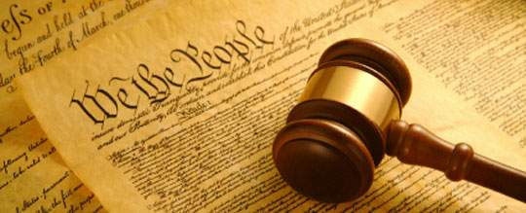
FUNDAMENTAL DUTIES
The Head Mistress of the school asked them to give in writing that they will respect the National Anthem, and instructed them until such assurance was not received; she shall not allow them to the classes. The children refused to do so.
As a result, the school management expelled those three children contending that they did not sing National Anthem and so they had acted against their fundamental duties. A writ was filed by Bijoe Emmanual, on behalf of the three children, before the Kerala High Court.
The Kerala High Court dismissed the writ petition and upheld the expulsion. It held that it is every citizen’s fundamental duty to respect the national integrity and to sing the national anthem, against the High Court order. The appellant appealed to the Supreme Court. The Supreme Court reversed the judgment of Kerala High Court. It gave judgment in favour of the appellant. It held that they did not commit any offence under National Honour Act, 1971.

Slide 89
FUNDAMENTAL DUTIES
Because they stood up respectfully when the National Anthem was being sung. The decision of Supreme Court caused annoyance in India. The decision was severely criticized by the press and public, it is criticized that because of such decisions, the binding force behind fundamental duties are only ornamental and there is need to implement duties properly.
In M.C. Mehta v. Union of India, (1983) 1 SCC 47 Held that under Article 51-A (g) it is the duty of the Central Government to introduce compulsory teaching of lesson at least for one hour in week on protection and improvement of natural environment in all the educational institutions of the country and also aware the people about consciousness of cleanliness of environment, finally it is concluded that Right without duties is nothing but a thing.
The National Commission to Review the Working of the Constitution, 2002, recommended addition of the following fundamental duties in Article 51A of the Constitution:

Slide 90
FUNDAMENTAL DUTIES
Duty to vote at elections
Duty to actively participate in the democratic process of governance
Duty to pay taxes
Duty to foster family values and responsible parenthood
Duty of industrial organizations to provide education to children of their employee

Slide 91
Constitutional Law, Cyber Law and Professional Ethics
DIRECTIVE PRINCIPLES OF STATE POLICY

Slide 92
DIRECTIVE PRINICIPLES OF STATE POLICY.
The ideas of the welfare state in India are embedded in the Directive Principles of State Policy enunciated in the Constitution of India.
Directive Principles of State Policy provide essential guide-lines both for the state as well as the citizens for establishing economic democracy in India.
The Constitution makers in India did not force on the people any economic system but they only tried to suggest a system which could be most suited to Indian conditions.
According to our Constitution Directive Principles, as against Fundamental Rights, are not justifiable in the courts of law. It is for the first time that a Part of Constitution (Part IV) has been devoted to these Principles.
There are some other countries of the world which have also incorporated directive principles in their constitutions

Slide 93
DIRECTIVE PRINICIPLES OF STATE POLICY.
Articles 36-51 under Part-IV of Indian Constitution deal with Directive Principles of State Policy (DPSP). They are borrowed from the Constitution of Ireland, which had copied it from the Spanish Constitution.
The Sapru Committee in 1945 suggested two categories of individual rights. One being justiciable and the other being non-justiciable rights. The justiciable rights, as we know, are the Fundamental rights, whereas the non-justiciable ones are the Directive Principles of State Policy
DPSP are ideals which are meant to be kept in mind by the state when it formulates policies and enacts laws. There are various definitions to Directive Principles of State which are given below:
They are an ‘instrument of instructions’ which are enumerated in the Government of India Act, 1935.
They seek to establish economic and social democracy in the country.
DPSPs are ideals which are not legally enforceable by the courts for their violation.

Slide 94
DIRECTIVE PRINICIPLES OF STATE POLICY.
Indian Constitution has not originally classified DPSPs but on the basis of their content and direction, they are usually classified into three types:
Socialistic Principles,
Gandhian Principles and,
Liberal-Intellectual Principles.
DPSP- Socialistic Principles
Article 38: Promote the welfare of the people by securing a social order through justice—social, economic and political—and to minimize inequalities in income, status, facilities and opportunities.
Article 39: Secure citizens:
Right to adequate means of livelihood for all citizens
Equitable distribution of material resources of the community for the common good
Prevention of concentration of wealth and means of production

Slide 95
DIRECTIVE PRINICIPLES OF STATE POLICY.
Equal pay for equal work for men and women
Preservation of the health and strength of workers and children against forcible abuse
Opportunities for the healthy development of children
Article 39A: Promote equal justice and free legal aid to the poor.
Article 41: In cases of unemployment, old age, sickness and disablement, secure citizens:
Right to work
Right to education
Right to public assistance.
Article 42: Make provision for just and humane conditions of work and maternity relief.

Slide 96
DIRECTIVE PRINICIPLES OF STATE POLICY.
Article 43:Secure a living wage, a decent standard of living and social and cultural opportunities for all workers
Article 43A: Take steps to secure the participation of workers in the management of industries
Article 47: Raise the level of nutrition and the standard of living of people and to improve public health
DPSP- Liberal- Intellectual Principles
Article 44: Secure for all citizens a uniform civil code throughout the country
Article 45: Provide early childhood care and education for all children until they complete the age of six years

Slide 97
DIRECTIVE PRINICIPLES OF STATE POLICY.
DPSP- GANDIAN PRINICIPLES
Article 40: Organise village panchayats and endow them with necessary powers and authority to enable them to function as units of self-government
Article 43: Promote cottage industries on an individual or co-operation basis in rural areas
Article 43B: Promote voluntary formation, autonomous functioning, democratic control and professional management of co-operative societies
Article 46: Promote the educational and economic interests of SCs, STs, and other weaker sections of the society and to protect them from social injustice and exploitation
Article 47: Prohibit the consumption of intoxicating drinks and drugs which are injurious to health

Slide 98
DIRECTIVE PRINICIPLES OF STATE POLICY.
Article 48: Prohibit the slaughter of cows, calves and other milch and draught cattle and to improve their breeds
DPSP- Liberal- Intellectual Principles
Article 44: Secure for all citizens a uniform civil code throughout the country
Article 45: Provide early childhood care and education for all children until they complete the age of six years
Article 48: Organize agriculture and animal husbandry on modern and scientific lines
Article 49: Protect monuments, places and objects of artistic or historic interest which are declared to be of national importance

Slide 99
DIRECTIVE PRINICIPLES OF STATE POLICY.
Article 50: Separate the judiciary from the executive in the public services of the State
Article 51: Promote international peace and security and maintain just and honorable relations between nations
Foster respect for international law and treaty obligations
Encourage settlement of international disputes by arbitration
42nd Amendment Act, 1976 added four new Directive Principles in the list:
Article 39: To secure opportunities for the healthy development of children
Article 39A: To promote equal justice and to provide free legal aid to the poor
Article 43A: To take steps to secure the participation of workers in the management of industries
Article 48A: To protect and improve the environment and to safeguard forests and wildlife

Slide 100
DIRECTIVE PRINICIPLES OF STATE POLICY.
A new DPSP under Article 38 was added by the 44th Amendment Act of 1978, which requires the State to minimize inequalities in income, status, facilities and opportunities.
The 86th Amendment Act of 2002 changed the subject-matter of Article 45 and made elementary education a fundamental right under Article 21A. The amended directive requires the State to provide early childhood care and education for all children until they complete the age of 14 years
A new DPSP under Article 43B was added by the 97th Amendment Act of 2011 relating to co-operative societies. It requires the state to promote voluntary formation, autonomous functioning, democratic control and professional management of co-operative societies.
The Indian Constitution under Article 37 makes it clear that ‘DPSPs are fundamental in the governance of the country and it shall be the duty of the state to apply these principles in making laws

Slide 101
DIRECTIVE PRINICIPLES OF STATE POLICY.
Criticism of Directive Principles of State Policy:
As a point of debate, the following reasons are stated for the criticism of Directive Principles of State Policy:
It has no legal force
It is illogically arranged
It is conservative in nature
It may produce constitutional conflict between Centre and State

Slide 102
Constitutional Law, Cyber Law and Professional Ethics
EMERGENCY

Slide 103
EMERGENCY (ARTICLE 352)
No part of the Indian Constitution has been the subject of more bitter attack by the critics than the one that deals with the Emergency Provisions (Part XVIII of the Constitution).
Many prominent members of the Constituent Assembly opposed the inclusion of these provisions in the Constitution as they thought that these were consistent with the democratic provisions embodied elsewhere.
However, the majority of the members favored the inclusion of these provisions, although unwillingly, as a precautionary measure, against possible disruptive forces destroying the newly established Union.
The Constitution provides for three different types of Emergency and in each case the President of India is empowered to declare the emergency.

Slide 104
EMERGENCY (ARTICLE 352)
National Emergency: If the President is satisfied that a grave emergency exists whereby the security of India or any part of its territory is threatened by war, external aggression or armed rebellion, he may proclaim a state of emergency under Article 352.
It may be proclaimed even before the actual occurrence when external aggression is apprehended. But no such proclamation can be made by the President unless the Union Ministers of Cabinet rank, headed by the Prime Minister, recommend to the President, in writing, that such a proclamation should be issued.
The proclamation may be revoked subsequently; if not, it shall be laid before both Houses of Parliament. If Parliament does not approve of it within one month, it will become invalid.
So far, there have been three occasions when emergency of the first category was proclaimed by the President: 1962 (Chinese aggression), 1971 (Indo-Pakistan war before the formation of Bangladesh) and 1975 (internal emergency).

Slide 105
EMERGENCY (ARTICLE 352)
State Emergency: If the President is satisfied on receipt of a report from the Governor or otherwise that a situation has arisen in which the Government of a State cannot be carried on in accordance with the provisions of the Constitution, he is empowered to proclaim an emergency under Article 356 and 365.
As a result,
He may assume to himself all or any of the functions of the State or he may vest all or any of those functions in the Governor or any other executive authority; or
He may declare that the powers of the State legislature shall be exercisable by Parliament; or
he may make any other incidental or consequential provisions necessary to give effect to the objects of the Proclamation

Slide 106
EMERGENCY (ARTICLE 352)
The President, however, cannot assume himself any of the powers vested in a High Court.
The proclamation may be revoked subsequently; if not, it shall be laid before both Houses of Parliament, if Parliament does not approve of it within two months, it will become ineffective.
Since the inauguration of the Constitution, this type of emergency has been declared almost 100 times. For the first time, constitutional emergency was declared in Punjab in 1952. The states which came under President’s rule for the maximum number of times were Kerala (9 times), followed by Punjab (8 times).
During the period of emergency, as declared under either of the two categories discussed above, the State is empowered to suspend the Fundamental Rights guaranteed under Article 19 of the Indian Constitution.

Slide 107
EMERGENCY (ARTICLE 352)
The term ‘State’ is used here in the same sense in which it has been used in the Part III on Fundamental Rights. It means that the power to suspend the operations of these Fundamental Rights is vested not only in Parliament but also in the Union Executive and even in a subordinate authority.
Further, the Constitution empowers the President to suspend the right to move any court of law for the enforcement of any of the Fundamental Rights. It means that virtually the whole Part on Fundamental Rights can be suspended during the operation of the emergency.
Financial Emergency (ARTICLE 360): If the President is satisfied that a situation has arisen whereby the financial stability or credit of India or any part of it is threatened, he may declare a financial emergency under Article 360. The proclamation in this case also should be approved by Parliament as in the other two cases of emergency.

Slide 108
EMERGENCY (ARTICLE 352)
During a financial emergency, “the executive authority of the Union shall extend to the giving of directions to any State, to observe such canons of financial propriety as may be specified in the direction, or any other directions which the President may deem necessary for the purpose.
Such directions may include those requiring the reduction of salaries and allowances of Government servants and even those of Judges of the Supreme Court and the High Courts.
An analysis of these instances would indicate the purpose and the manner in which, in actual practice, a proclamation of emergency in the States will be made by the President. These may be summed up in the following terms:
The essential condition for the intervention by the Centre is the Political instability of the State, that is, the virtual breakdown of the Parliamentary System of the Government

Slide 109
EMERGENCY (ARTICLE 352)
The Union will watch the situation of instability with utmost caution and provide every opportunity for the formation of an alternative ministry.
The proclamation of emergency will only be the last resort when (i) the existing ministry does not have the confidence of the legislature; and (ii) no alternative ministry can be formed.
During the period of emergency the legislative work of the State will be transferred to the Parliament. Delegation of such work to any administrative body will be reduced to the minimum.
As soon as the political situation within the State becomes conducive to a responsible Government, it will be restored

Slide 110
EMERGENCY (ARTICLE 352)
During a period of emergency, it is natural that the Executive becomes unusually powerful. Hence, the Parliament has the power to check the Executive whenever the latter goes beyond reasonable limits.
Emergency provisions do not, in any way, cut Parliament out of the picture and Parliament has always the right to call the Executive to order; and if they find that the Executive has exceeded its powers in regard to the operation of any of the provisions enacted under the emergency laws, they can always pull it up, even dismiss the ministry and replace it.
The only exception to this practice was the internal emergency period of 1975-77. There was widespread abuse of executive power in many parts of the country in many forms during this period. The extent of abuse became clear only after the lifting of emergency in 1977

Slide 111
EMERGENCY (ARTICLE 352)
Naturally, the new Parliament which came into being after the general elections of March 1977 was interested in preventing the repetition of such a situation in future and hence initiated steps to amend the Constitution suitably to limit the powers of the Government to proclaim internal emergency.
The 44th Constitutional Amendment adopted by Parliament in December 1978 ensures that the proclamation of emergency can be made only on the basis of written advice tendered to the President by the Cabinet.
Internal disturbance not amounting to armed rebellion will no longer be a ground for declaration of emergency. Emergency can be proclaimed only when the security of the country is threatened by war, external aggression or armed rebellion.
As an additional safeguard, proclamation of emergency will require approval within a month by a resolution of Parliament, by a majority of the total membership and not less than two-thirds of the members present and voting.

Slide 112
EMERGENCY (ARTICLE 352)
The provision for the suspension of Constitutional rights does not mean, however, that with the proclamation of emergency, there will be an automatic suspension of Fundamental Rights. It may be quite possible to keep the enforcement of the Fundamental Rights intact and there need not be a universal suspension throughout the country merely by reason of the proclamation.
Further, the order of suspension should be placed before Parliament and it will be free to take whatever action it deems fit.
The working of the Constitution, so far, shows that the suspension of Fundamental Rights took place rarely- That happened as a result of the proclamation of national emergency in 1962, 1971 and 1975.
In contrast to the national emergencies mentioned above, Fundamental Rights were never suspended during any of the emergencies proclaimed in the States. That remains a good precedent. Even during the national emergency, suspension of Fundamental Rights should be restricted to the absolute minimum.

Slide 113
Constitutional Law, Cyber Law and Professional Ethics
AMENDMENT OF CONSTITUTION OF INDIA

Slide 114
AMENDMENT OF CONSTITUTION
A written constitution must definitely contain the method or procedure for amending the constitution and it is regarded as an essential part of every written constitution.
No written constitution is complete without such a provision. “Human societies must grow and develop with the lapse of time, and unless provision is made for such constitutional readjustment as their internal development requires, they must stagnate or retrogress.”
Pandit Jawaharlal Nehru, India’s First Prime Minister, had once said that the Constitution should not be so rigid that it fails to adapt itself to the changing needs of national development and strength.
Therefore, the amendment to the Constitution was thought to be a necessity for the Constitution makers. Article 368 of the Indian Constitution deals with the amendment procedure.

Slide 115
AMENDMENT OF CONSTITUTION
A major feature of the Constitution of India is that it is neither too rigid nor too flexible. It allows modifications to be made since time is not static. Societies evolve with time, and the law needs to adapt to the same.
Procedure for Amendment
An amendment to the Constitution of India may be allowed by the introduction of a Bill for the purpose in either House of the Parliament (Lok Sabha or Rajya Sabha). The bill has to be passed in each house by a majority, which is more than 50% of the total membership of that House and by a majority of not less than two-thirds of the members of the House present and voting.
Then the Bill goes to the President of India for his assent and when such assent is given, the Bill becomes an Act.

Slide 116
AMENDMENT OF CONSTITUTION
Step 3
After acquiring the majority, the Bill is presented to the President who will then give his assent to the Bill.
In the case of amendment of provisions mentioned in Article 368, It needs to be ratified by not less than half of the states. Ratification should be done by a resolution passed by the state legislature. However, this must be passed before the amendment Bill is presented to the President for his assent
Basic Structure: The Basic Structure Doctrine states there are certain fundamental structures and founding principles of the constitution which make the backbone of the constitution. In simple terms, they are ideologies of the constitution which are essential for the survival of the constitution

Slide 117
AMENDMENT OF CONSTITUTION
Features of the Amending Procedure
The procedure for amendment in India is not as plicated as the system in the U.S.A or in any other rigid Constitution
Our Constitution vests constituent power upon the ordinary legislature, i.e., the Parliament of India and there is no separate body that functions for amending the Constitution of India.
The State Legislatures do not have the authority to initiate any Bill or proposal for amending the Constitution of India. The only procedure is initiating the Bill through the Union Legislature, i.e., the Parliament of India.
Subject to the provisions of Article 368, the Amendment Bills to the Constitution of India can be passed in the same way as ordinary Bills in the Parliament of India.

Slide 118
AMENDMENT OF CONSTITUTION
Prior sanction of the President of India is not required for introducing any Bill in the Parliament for amendment of the Constitution of India.
Ratification by not less than half of the States.
Landmark Supreme Court judgments
Shankari Prasad v. Union of India ( AIR 1951 SC 455) was the first time when the question of whether Fundamental Rights enshrined under Part III of the Constitution of India, can be amended under Article 368. In this case, the validity of the First Constitutional Amendment was challenged, which had added Article 31A and 31B to the Constitution of India. The Five Judge Bench had stated. Article 368 provides for general and strict power to the Parliament of India to amend the Constitution.

Slide 119
AMENDMENT OF CONSTITUTION
Golaknath v. State of Punjab (1967 AIR 1643) was the case where three amendments, namely, the first, fourth, and seventeenth amendments, were challenged. The bench had eleven judges out of which the majority six-judge bench held that Part 3 of the Constitution (Fundamental Rights) could not be amended by the Parliament of India. Post this judgment of the apex court, and the 24th Amendment was passed in the year 1971, which introduced a change in Article 13 and 368 of the Constitution of India.
Keshvananda Bharati v. Union of India (1973) 4 SCC 225) was a landmark case where for the first time, the Supreme Court brought in the doctrine of Basic Structure. The court overruled the judgment of the Golaknath case, and the validity of the 24th, 25th, and the 29th amendment was questioned. Also, the apex court held that article 368 of the Constitution does not empower the Parliament to change, damage, or alter the basic structure of the Constitution of India. The Preamble is actually the basic structure of the Constitution of India.

Slide 120
AMENDMENT OF CONSTITUTION
The same judgment was followed in the case of Indira Nehru Gandhi v. Raj Narayan.
42nd Amendment
42nd Amendment to the Constitution of India added the words “secular” and “socialist” to the Constitution of India and added clause 4 and 5 to Article 368. This amendment recognized the ultimate power of the Parliament in amending the Constitution of India even after the Supreme Court judgments of Keshvananda. Bharati and Raj Narayan
Article 368 of the Constitution of India provides for the procedure of Amendment to the Constitution of India. The Constitution is neither too rigid nor too flexible. As of March 2019, there have been 103 amendments to the Constitution of India since 1950

Slide 121
Constitutional Law, Cyber Law and Professional Ethics
THANK YOU
Faculty of Law

